Slide 1


Packet Inspection to detect attacks using machine learning models
Presentatio
By: Hussein Salloum
Supervised by:
Dr – Sameeh Jammoul
Dr- Mohammad Bashar Dasouki

Slide 2
Project Objective

Slide 3
Project Requirements

Slide 4
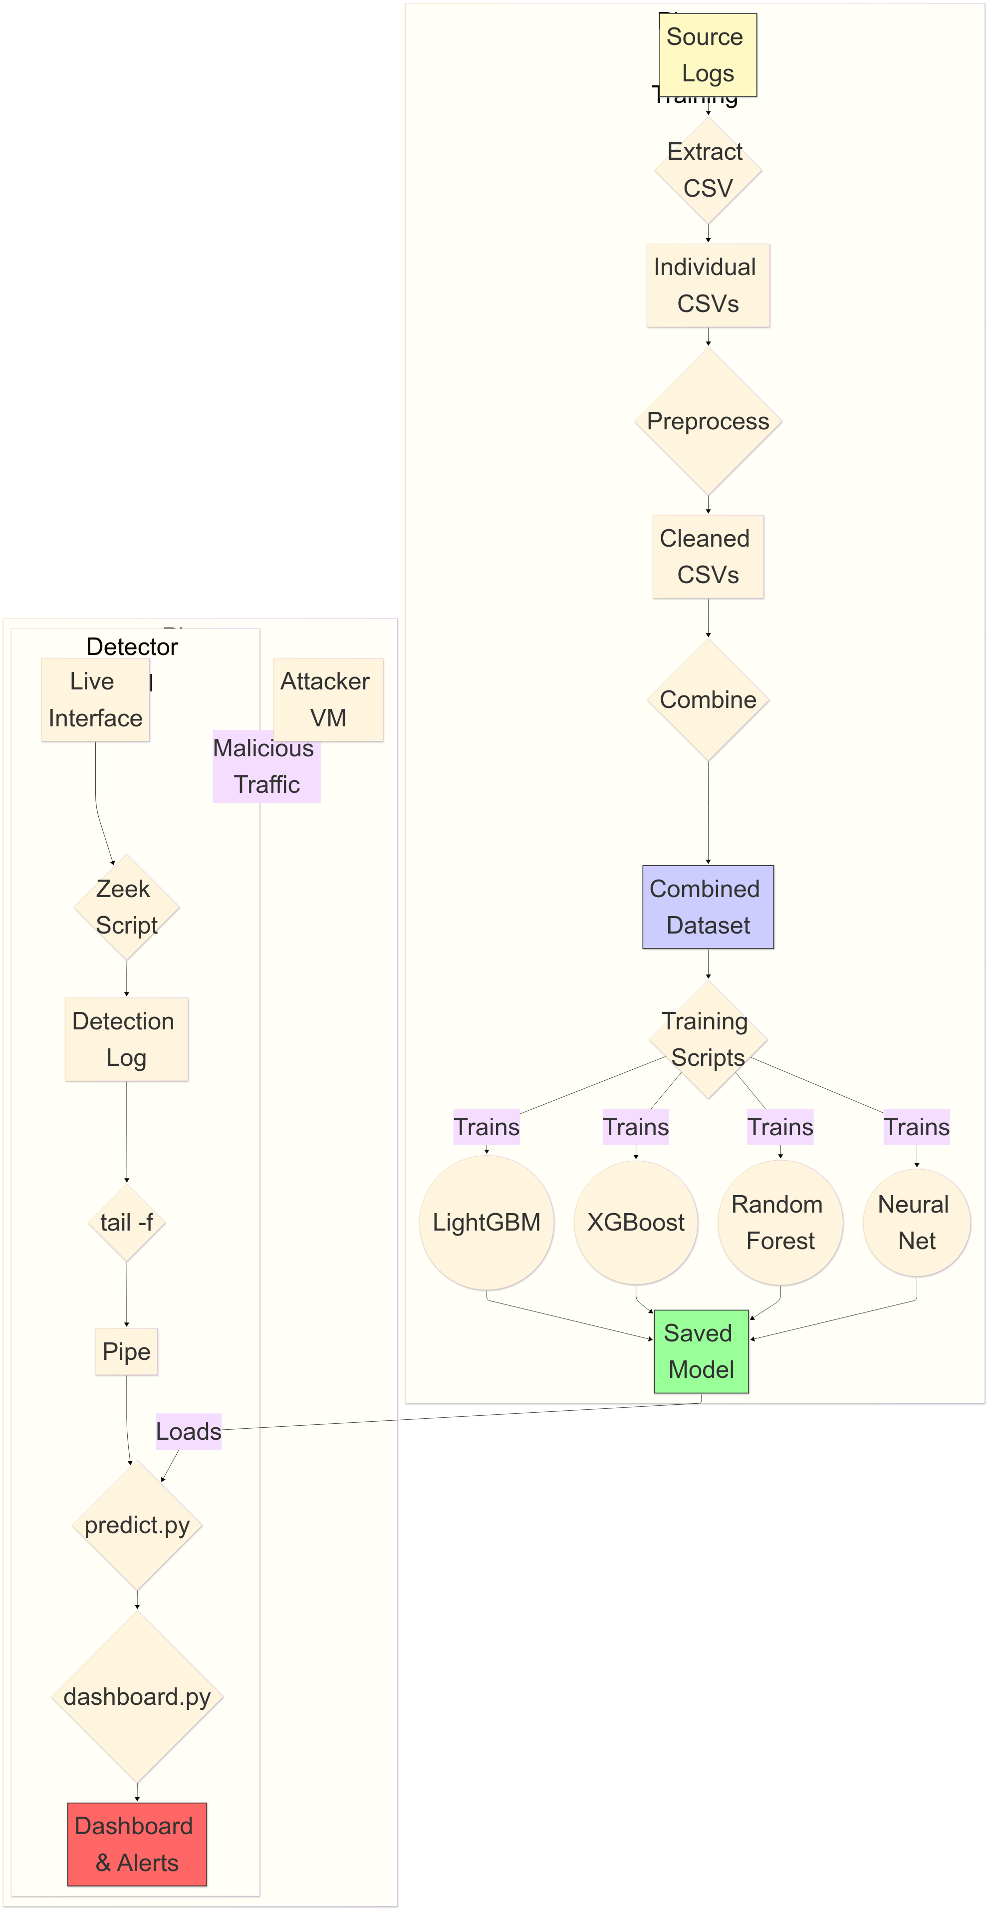

System Block Diagram
1

Slide 5

Preprocessing IoT-23 Dataset
Dataset features: in bold are the used features:
ts ,uid, id.orig_h, id.orig_p, id.resp_h, id.resp_p, proto, service, duration, orig_bytes, resp_bytes, conn_state, local_orig, local_resp, missed_bytes, history, orig_pkts, orig_ip_bytes, resp_pkts, resp_ip_bytes, Label
encoding_map = {
"proto": {"icmp": 0,"tcp": 1,"udp": 2,"UNKNOWN": -1},
"service": {"-": 0,"dhcp": 1, "dns": 2, "http": 3,"ssh": 4,"ssl": 5,
"irc": 6, "UNKNOWN": -1},
"conn_state": {"S0": 0,"S1": 1,"S2": 2,"S3": 3,"SF": 4,"REJ": 5,
"RSTO": 6,"RSTR": 7,"RSTOS0": 8,"RSTRH": 9,"SH": 10,"SHR": 11,
"OTH": 12,"UNKNOWN": -1}}
Handling nan values for {'duration', 'orig_bytes', 'resp_bytes’} features:
Conn_state=0 ➔ 0s conn_satae!=0 ➔ medians

Slide 6
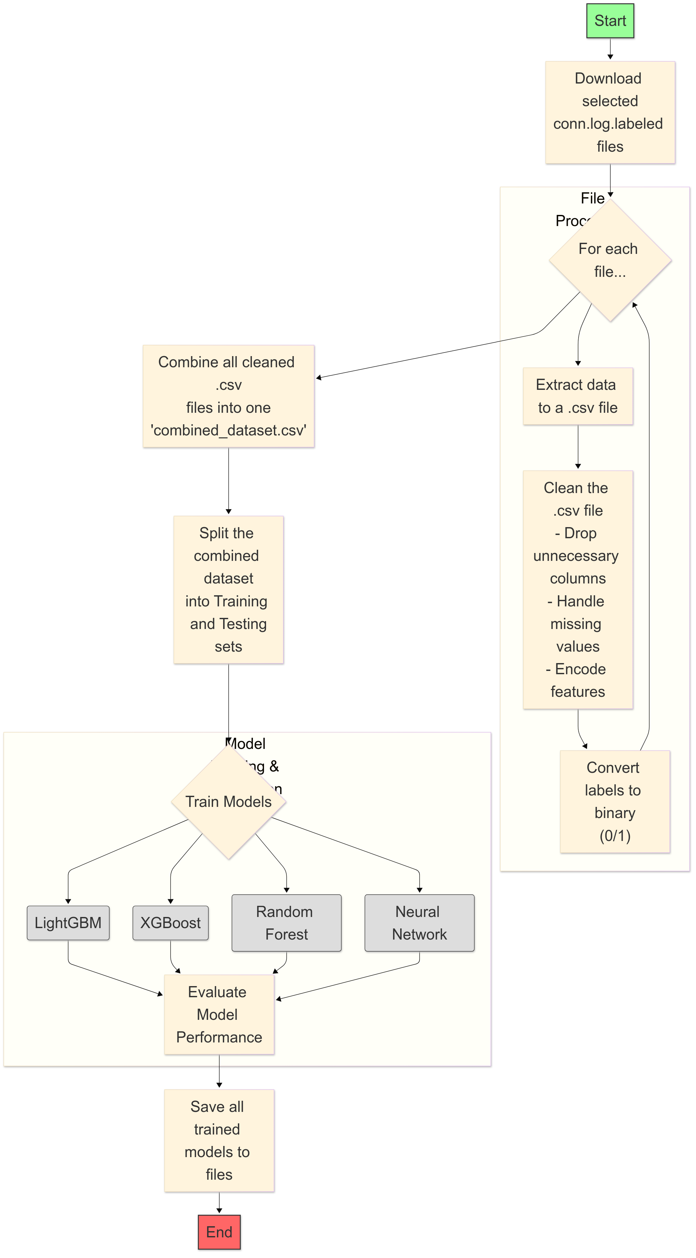
Training Flow Chart

Slide 7
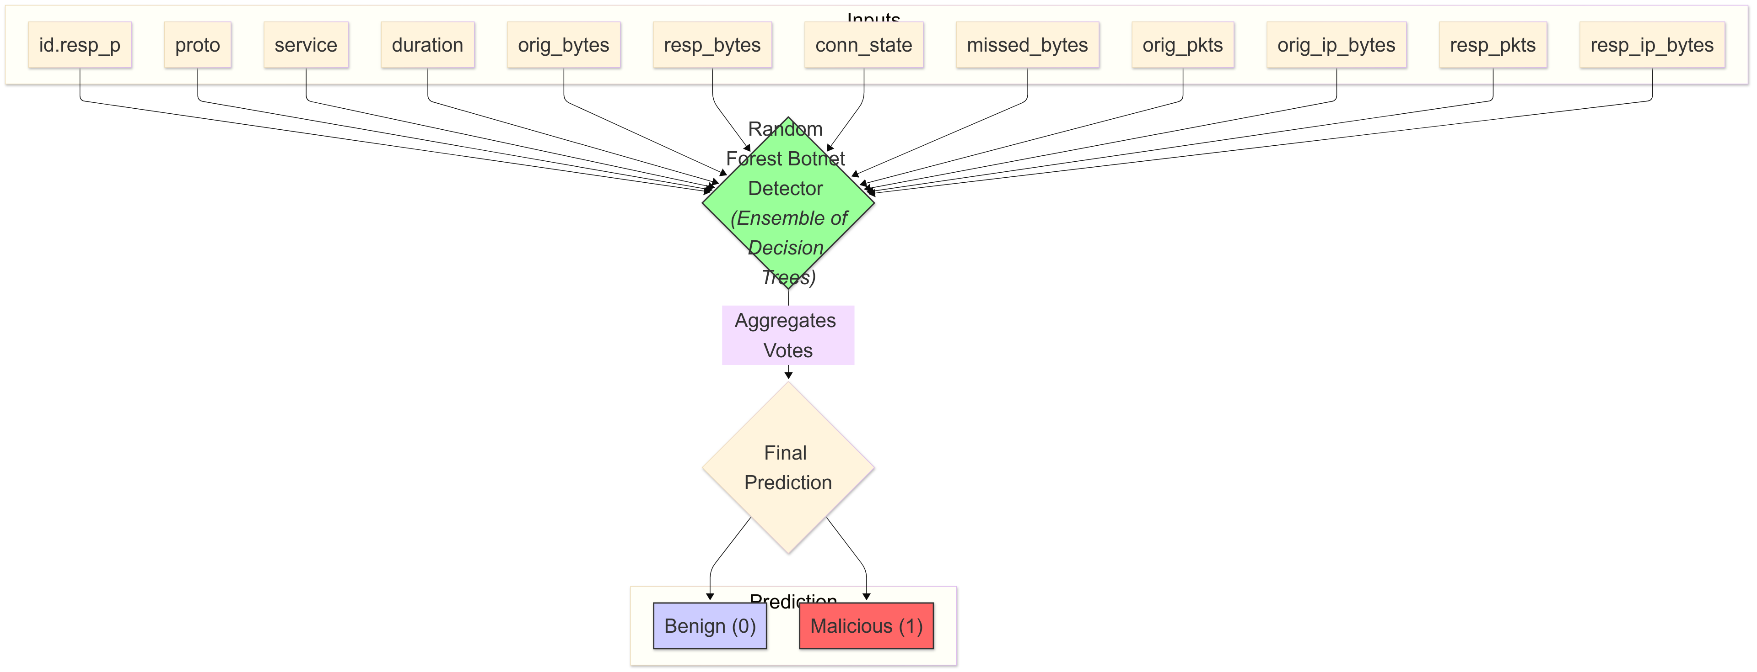
Random Forest

Slide 8
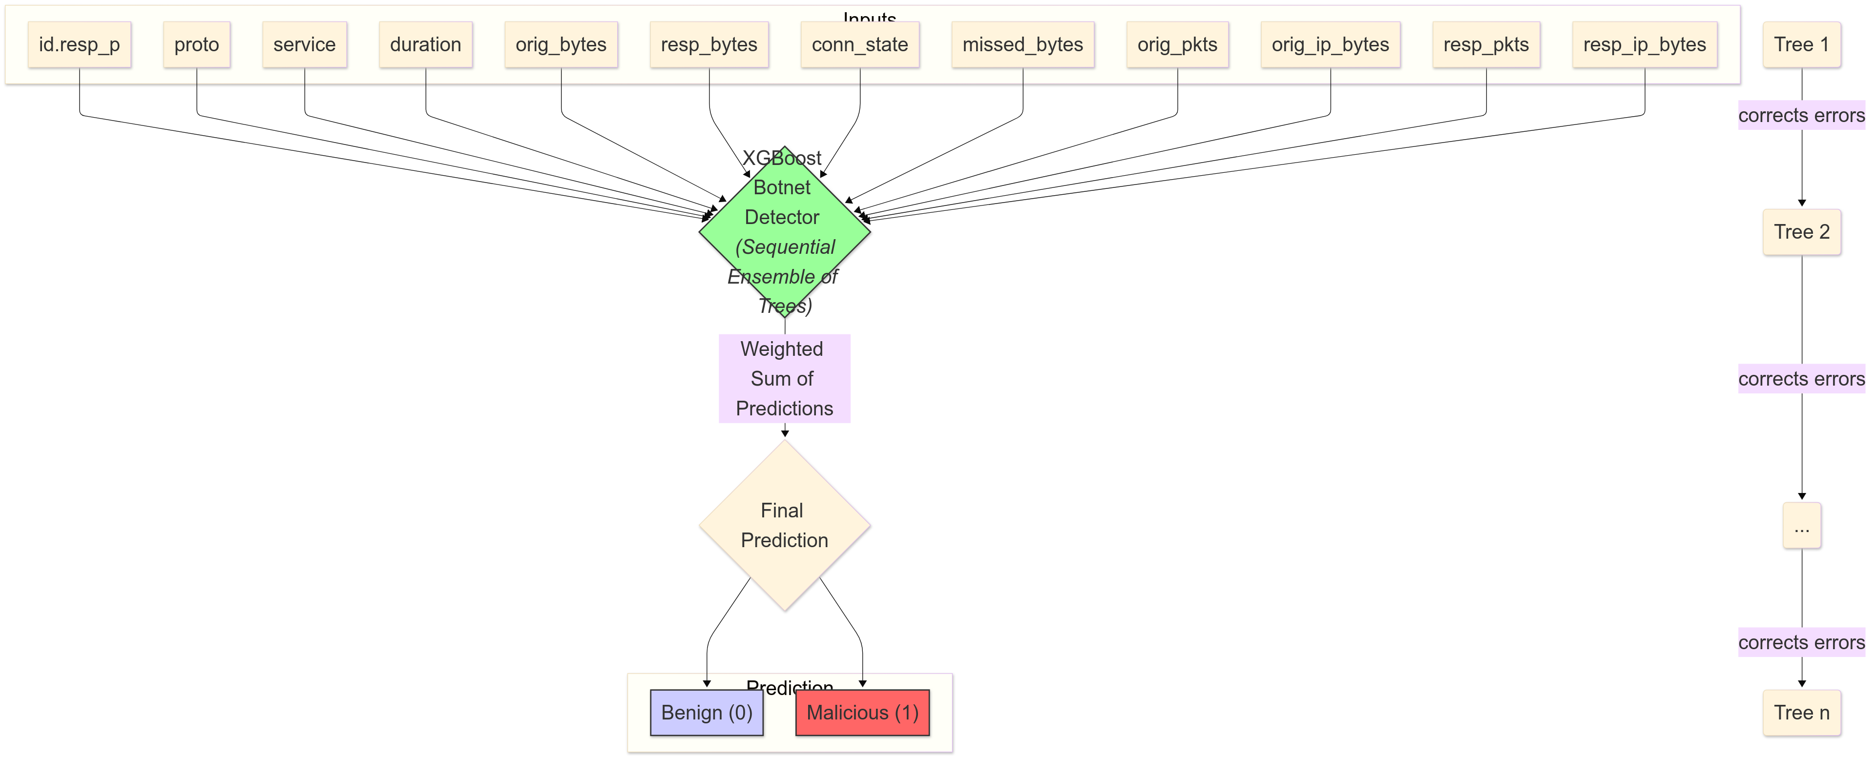
Xgboost

Slide 9
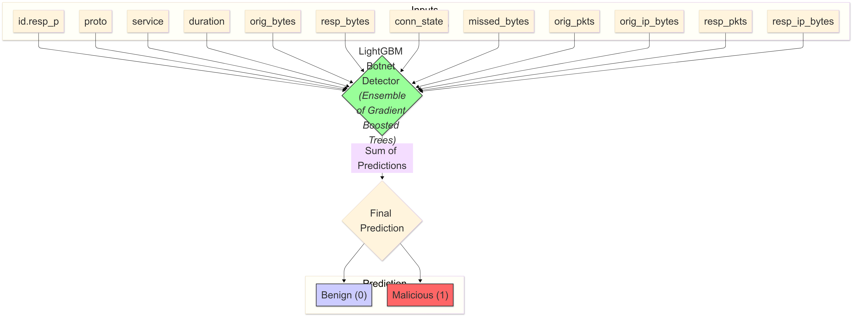
Lightgbm

Slide 10
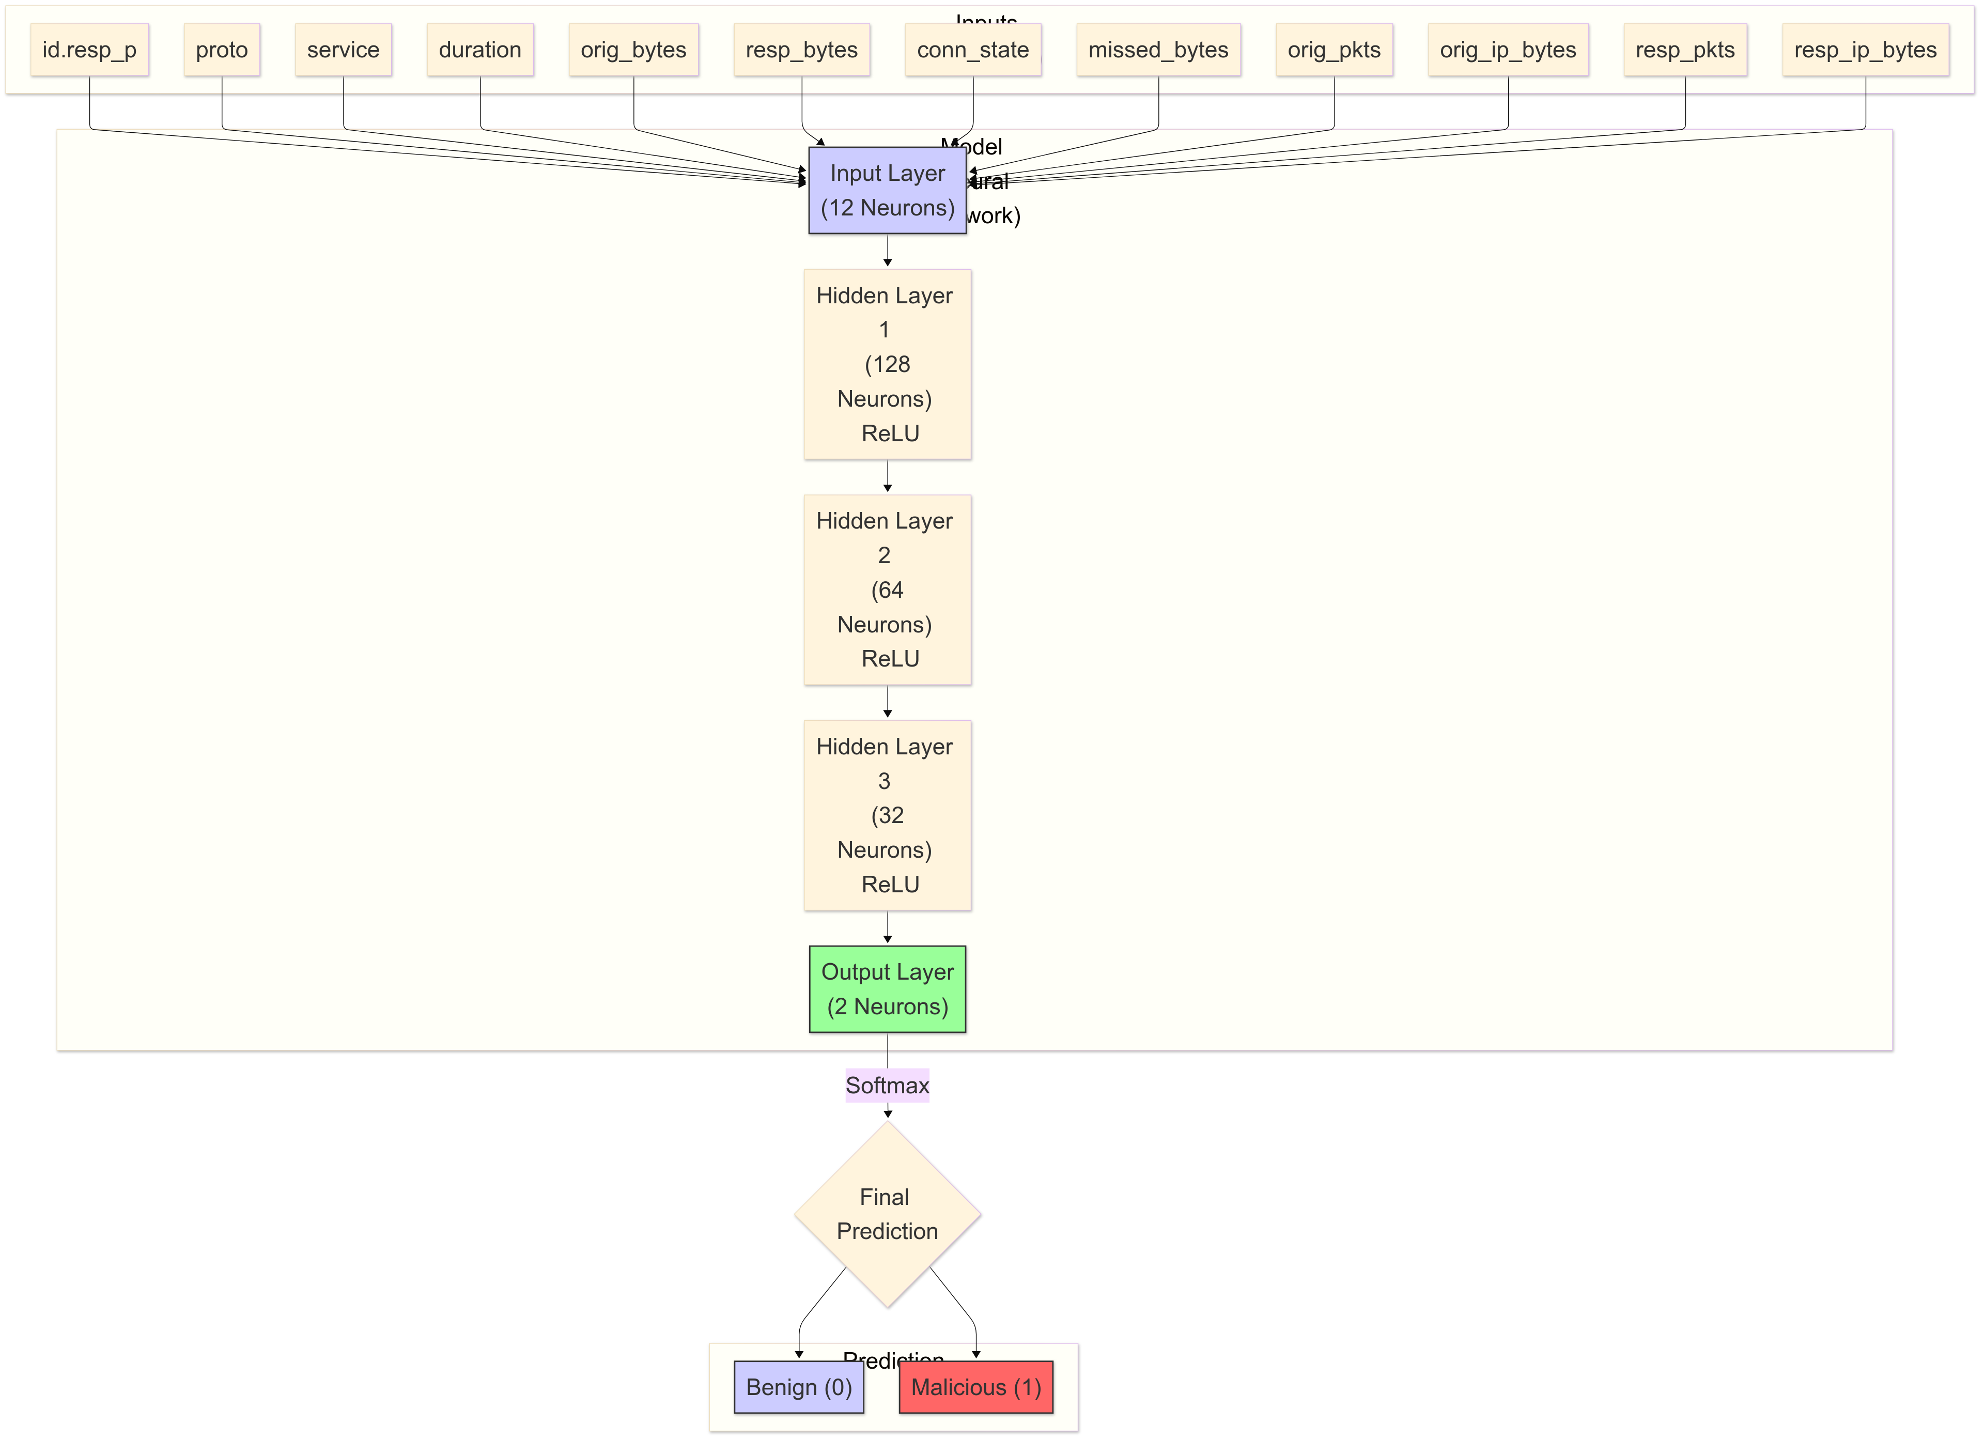
Neural Network

Slide 11





Tools Used

Slide 12
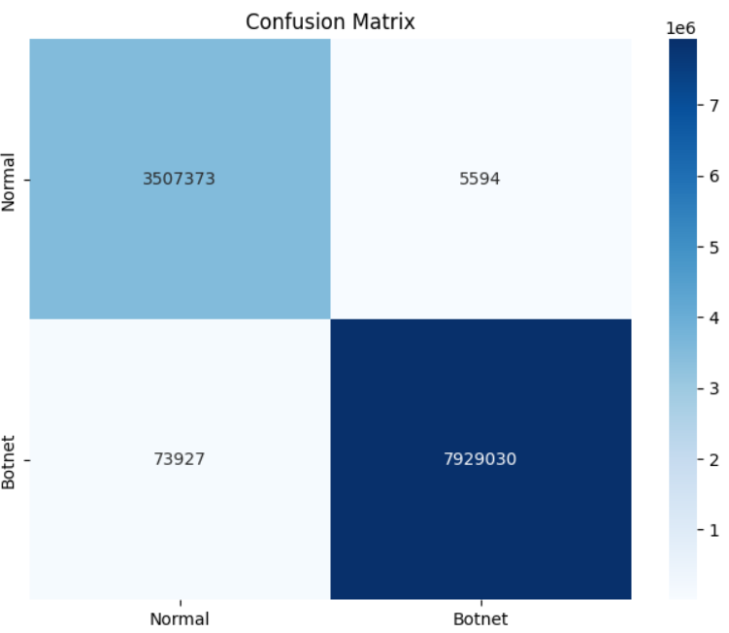
Xgboost confusion matrix

Slide 13
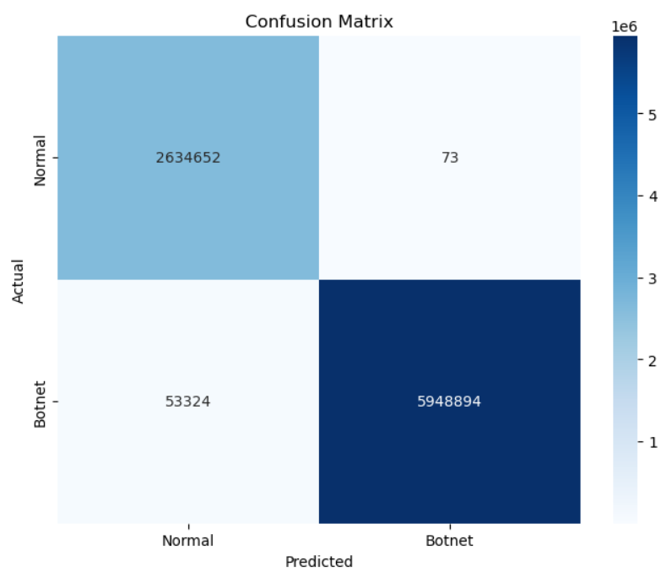
Random Forest confusion matrix

Slide 14
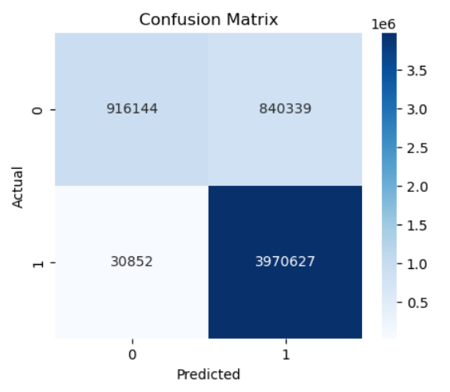
Neural network confusion matrix

Slide 15
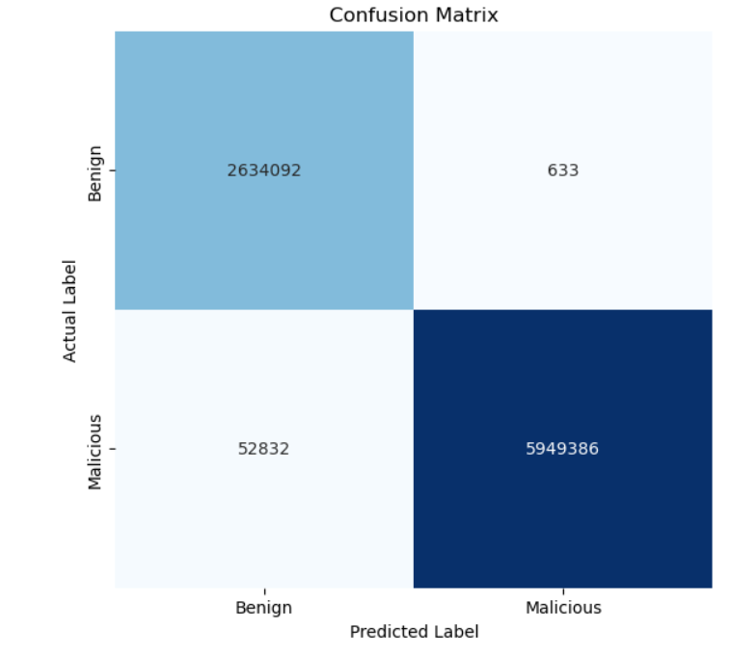
Light gbm confusion matrix

Slide 16
Model | Accuracy | Precision | Recall | F1-Score
Random Forest | 0.9938 | 1 | 0.9911 | 0.9955
XGBoost | 0.9931 | 0.9993 | 0.9908 | 0.9950
LightGBM | 0.9938 | 0.9999 | 0.9912 | 0.9955
Neural Network | 0.8487 | 0.8253 | 0.9923 | 0.9011
Evaluation metrics

Slide 17
Light gbm confusion matrix

Slide 18
LightGBM

Slide 19
Previous papers (Austin, 2021)
1,027,714 rows * 15 features
Random forest: باستخدام 50 شجرة قرار كل واحده بعمق 6 عقد.
Naïve Baes: واستخدم الGaussian naïve bayes
Support Vector Machine: واستخدم linear svm
Stochastic Gradient Descent: مصنف خطي تم تحسينه باستخدام SGD
Used these features: time of day, id.orig_p, id.resp_p, proto, service, duration, orig_bytes, resp_bytes, missed_bytes, history, orig_pkts, orig_ip_btes, resp_pkts, resp_ip_bytes, Label

Slide 20
Previous papers (Austin, 2021)
His results
Our results
Model | Accuracy | F1-Score | Precision | Recall
Random Forest | 97.45 | 97.39% | 99.92% | 94.98%
Naïve Bayes | 94.19% | 94.50% | 89.75% | 99.75%
Linear SVM | 91.72% | 92.33% | 85.85% | 99.90%
Stochastic Gradient Descent | 94.45% | 94.41% | 95.33% | 93.51%
Model | Accuracy | Precision | Recall | F1-Score
Random Forest | 0.9938 | 1 | 0.9911 | 0.9955
XGBoost | 0.9931 | 0.9993 | 0.9908 | 0.9950
LightGBM | 0.9938 | 0.9999 | 0.9912 | 0.9955
Neural Network | 0.8487 | 0.8253 | 0.9923 | 0.9011

Slide 21
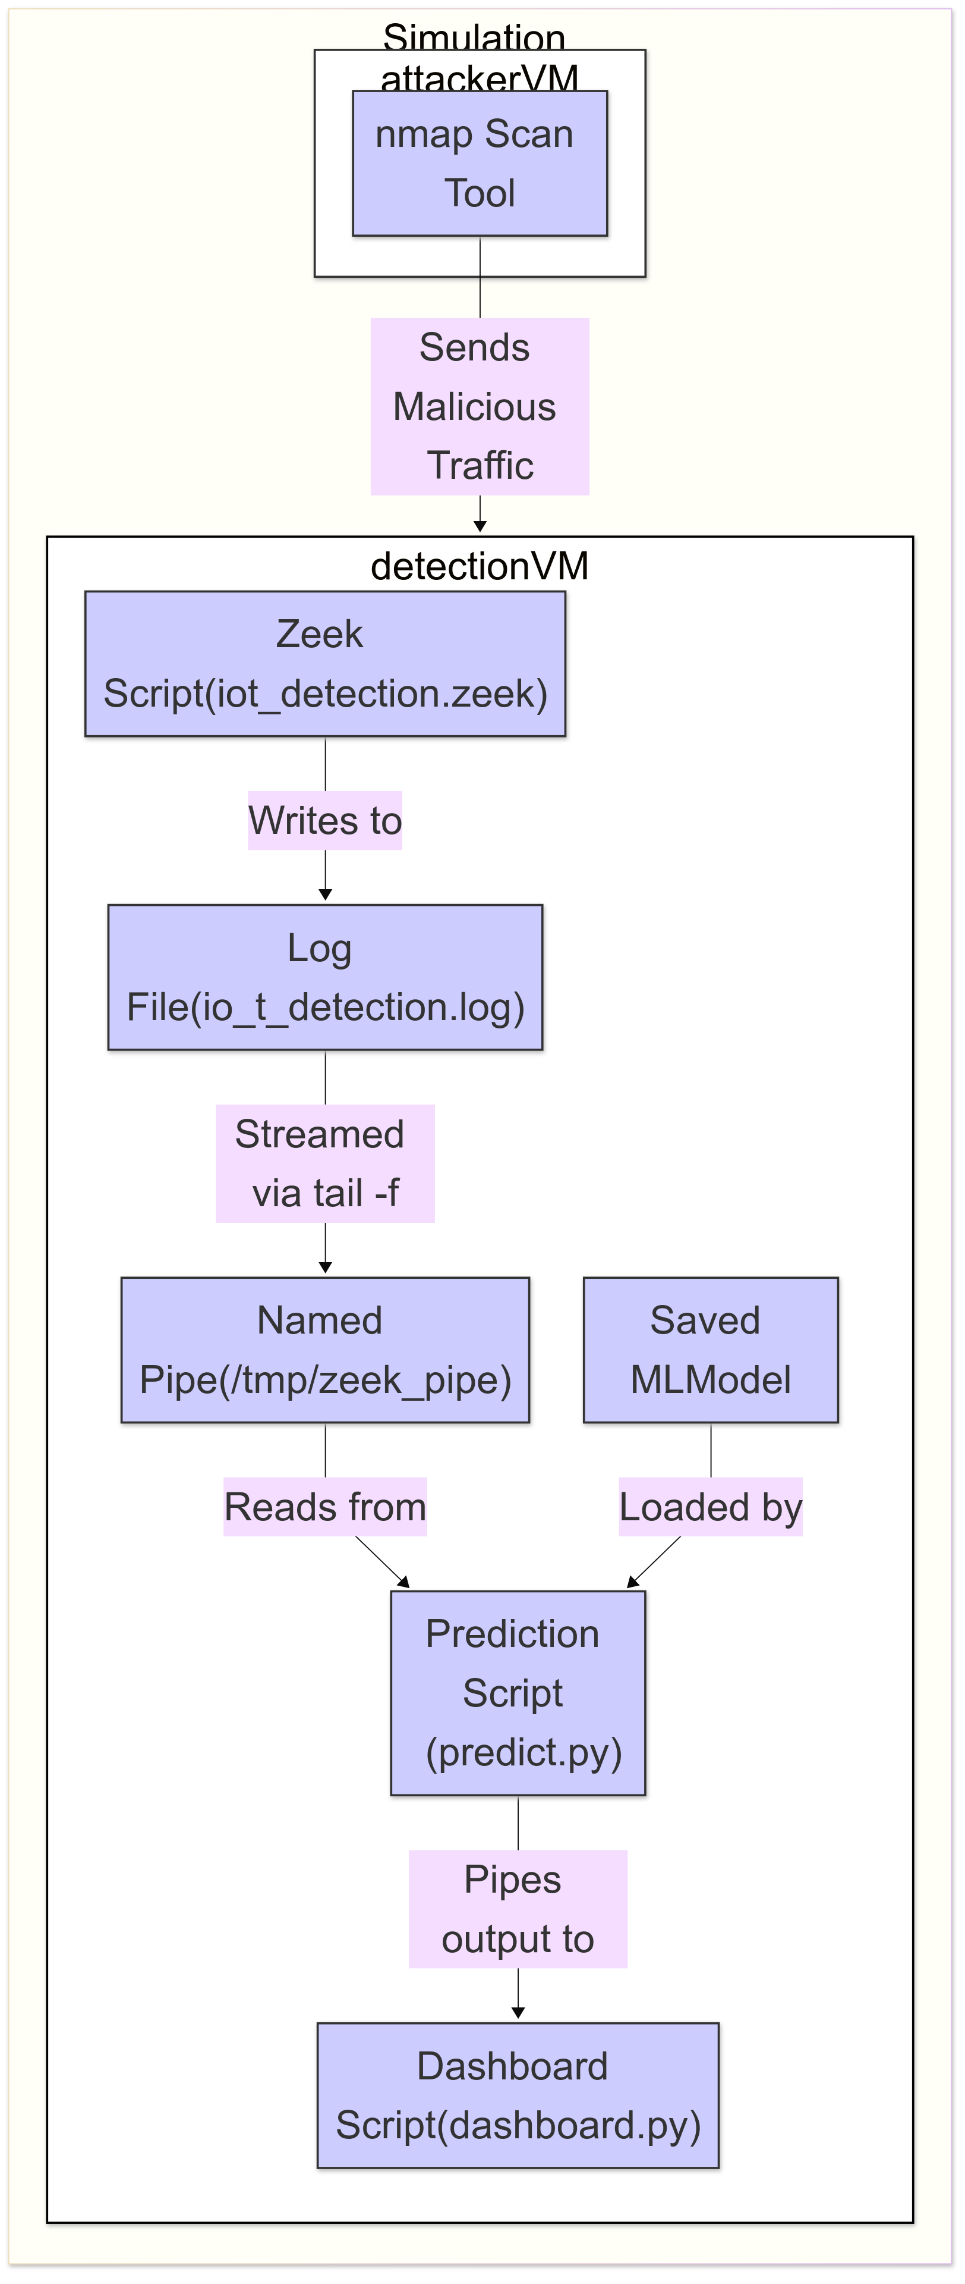
Simulation
Video

Slide 22
CONCLUSION

